Slide 1
“SEDIMENTARY SIMULATIONS & SEDPAK INTRODUCTION”
Christopher G. St.C. Kendall
803 – 312 1569
kendall@geol.sc.edu
Phil Moore

Slide 2
Objectives
Gain experience with stratigraphic/sedimentary computer simulations to solve sequence stratigraphic problems:
Principles of sequence stratigraphy, and the effect of eustasy, tectonics, & sedimentation on distribution of basin fill geometries.
Test sequence stratigraphic interpretations & models of sedimentary fill.
Source of simulation inputs, including initial basin shape, accommodation history (tectonic & eustatic), & sediment accumulation history.
Identify & predict geometries & lithofacies variation within sedimentary sequences.
Determine age of sequence boundaries & establish timing of events.

Slide 3
Sequence Stratigraphic Principles
Sequence stratigraphy subdivides sedimentary section into chronostratigraphic units tied to sea level change
A “sequence” is a relatively conformable succession of strata bounded by unconformities (Vail et al, 1977)
“Parasequences (Cycles?)” & “parasequence (cycle?) sets ” are relatively conformable succession of genetically related beds or bedsets identified by transgressive surfaces, maximum flooding surfaces & unconformities within a sequence
These surfaces & associated strata form in response to changes in accommodation (relative sea level) & rates of sedimentation
This approach enables prediction of continuity & identification & character of sedimentary bodies using seismic cross-sections, well logs & outcrop studies of sedimentary rocks

Slide 4
Sequence Stratigraphic Principles

Slide 5
Sequence Stratigraphic Principles
Carbonate Cycles
Carbonate “Cycles” & “cycle sets” are relatively conformable successions of genetically related beds or bedsets identified by transgressive surfaces, maximum flooding surfaces & unconformities within a sequence.

Slide 6
Sequence Stratigraphic Principles

Slide 7
Sequence Stratigraphic Principles

Slide 8
Sequence Stratigraphic Principles

Slide 9
Stratigraphic Interpretation Methods
Sequence stratigraphy used to identify & predict lithofacies geometries & establish their relative timing
Primary data sources outcrops, well logs & seismic
Identify sequence boundaries, trangressive surfaces, & maximum flooding surfaces
Onlap, downlap, and toplap reflector relationships
Stacked sediment geometries in terms of progradation, aggradation & retrogradation
Lithofacies character
Tie events to well logs and 1D synthetics
Assign relative ages based on biostratigraphy
Resulting sequence stratigraphic models predict reservoir, source & seal character, enhanced by forward sedimentary simulation using Haq et al. (1987) sea level chart to test & predict sequence stratigraphic interpretation

Slide 10
Why Use Simulations
"I learned things .. I hadn't known before. I found [simulations] to be a great springboard for ideas."
Art Browning, Amoco Production Company
" It provides realistic sedimentological constraints on facies interpretations from seismic records and well log cross sections."
Robert W. Scott, Amoco Production Company
“Check on the geologic conditions required to reproduce the interpreted stratal relationships."
Susan Nissen, Amoco Production Company
“Know which aspects of the interpretation influence the stratigraphy the most - hence, which things you need to be right about, and which things are less critical."
Elizabeth Lorenzetti, Texaco Inc.

Slide 11
Establish Timing of Events
Why Use Simulations
Defines chronostratigraphic framework for deposition of sediments & illustrates relationship between sequences & systems tracts through integration of cores, outcrop, well & seismic data
A means of quantifying models which explain & predict stratal geometries produced between sequence stratigraphic boundaries & complex sediment geometries & architectures
Enhances biostratigraphic studies providing age constraints for stratal geometries & sequence stratigraphic interpretations by tying stratigraphy to established sea level charts & matching simulation to interpretation
Examples: Prediction of Chronostratigraphy
Neogene carbonates of the Great Bahamas
Neogene siliciclastics of the Baltimore Canyon

Slide 12
Confirm Magnitude of Eustatic events
Haq et al chart eustatic size & frequency to determine residual components of sedimentary systems; tectonics & sedimentation
Used where rate, direction & amplitude of tectonic movement & rate of sediment accumulation known; & constant
e.g. Isolated carbonate platforms peripheral
to continental margins
Simulations using the Haq et al 1987 chart, constant rates of subsidence & rates of carbonate accumulation which result in geometries that match the interpreted sequence geometries suggest the size of the Haq et al sea level excursions
Examples: Neogene carbonates of Great Bahamas

Slide 13
Identification of Lithofacies
Characterizes facies based on lithology, water depth, porosity
Tracks evolution of facies through time in response to sedimentation, eustasy and tectonic events
Illustrates the relationship between sequences and systems tracts thereby enabling identification of reservoir sands, source and seal
Examples:
- Neogene carbonates of the Western Great Bahamas Platform (Eberli and Ginsburg, 1989)
- Neogene siliciclastics of the Baltimore Canyon, Offshore New Jersey (Greenlee et al., 1992)
- Early Mesozoic mixed siliciclastic and carbonate sediments of the Neuquen Basin, Argentina (Mitchum and Uliana, 1985)

Slide 14
Testing Models & Interpretations
Interpretation works backward from data, experience & analogy
Modeling proceeds forward through well defined & reproducible mechanisms
Identifies & constrains key factors that control sequence stratigraphic geometries & architectures; includes rates of sedimentation, slope angles, distance of sediment transport into basin, eustatic sea level, & tectonics
Enables examination of 'what if' scenarios for understanding of how each input parameter affects basin evolution
Determines if one a hypothesis better than another?
Examples: Prediction of Chronostratigraphy
Neogene carbonates of the Great Bahamas
Neogene siliciclastics of the Baltimore Canyon

Slide 15
Carbonate Modeling
Uses math as a language to describe physical relationships
How?
What?
Why?
Who?
Where to now?

Slide 16
Linked to Sequence Stratigraphic Principles
RELATIONSHIP BETWEEN
THEORIES & “REALITY”
HYPOTHESES
Induction
Deduction
EMPIRICAL
RELATIONSHIPS
THEORY
Analysis
Model
OBSERVATIONS OF THE WORLD

Slide 17
Role of Logic
Deterministic models are as good as science used to build them - both strength & weakness of deterministic modeling
Deductive & inductive components
Compromise between realism & mathematical over-simplicity. This degrades strict application of goodness of fit tests for models with unrealistic stochastic components.

Slide 18
Common Themes
Carbonate models are a mix of process driven empirical, and deterministic
Input variables are know but their value has to inferred from the geologic record
Carbonate models are going 3D
Subsurface models commonly oil field based

Slide 19
Who are some of the carbonate modelers?
Aigner – Forward Empirical Deterministic 2D
Bosence, Waltham & Warrlich - 3D Process Forward & Fieldwork
Bosscher – Process 2D Forward Model
Bowman - Forward Empirical Deterministic 2D
Cowell - Process Deterministic Shoreface Model
Cross and Duan – 3D Forward Model
Demicco - Fuzzy Modeling

Slide 20
Who are some of the carbonate modelers?
Flemmings - Meter-scale shallowing cycles
Goldhammer - High-frequency platform carbonate cycles
Granjeon - Diffusion-based stratigraphic model
Kendall – Forward Empirical Deterministic 2D
Ulf Nordlund - Fuzzy logic
Read - Forward Empirical Deterministic 2D
Rivanaes - Depth-dependent diffusion models of erosion, transport & sedimentation

Slide 21
Common Themes & Future
Carbonate models are a mix of process driven empirical, and deterministic
Input variables are know but their value has to inferred from the geologic record
Carbonate models are going 3D
Subsurface models commonly oil field based
Backstripped interpreted sections replacing models
Surrealistic movies worth a thousand words
Need work with a setting like Arabian Gulf

Slide 22
SEDPAK & Carbonates
An example of sedimentary simulations
Most other models follow many of the same paths of logic that SEDPAK follows

Slide 23
Basin Sedimentary Fill - Major Controls
EUSTATIC
RISE & FALL
RATE
VARIATIONS
SUBSIDENCE
/UPLIFT
SEDIMENT
SUPPLY

Slide 24
Basin Sedimentary Fill - Major Controls
Sea level position, tectonic movement & sedimentation vary independently.
Tectonic movement is vertical, combining crustal cooling & isostatic response to sediment loading. Subsidence due to compaction is handled separately.
Clastics deposited first as a ratio of lithology, filling accommodation landward of the depositional shoreline break (Posamentier & Vail, 1988) as shallow marine & alluvial sediments
Next sediment is deposited in the submarine setting downslope from the depositional shoreline break to a prescribed distance on underlying surfaces that are inclined up to a specified angle
Simultaneous with deposition, sediment is eroded & added to the sediment supply
Benthic carbonates accumulate next as a function of water depth
SEDPAK creates a 2D grid of data values by linearly interpolating between the input values & extrapolating from intermediate input values if start or end values are undefined.

Slide 25
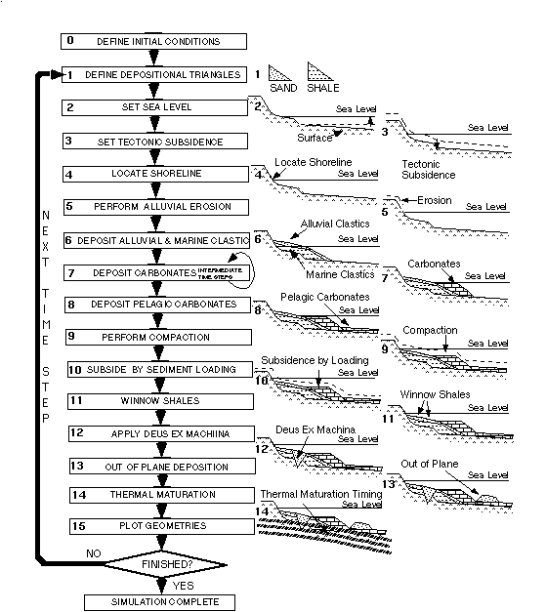
Sedpak Simulation - Basin Fill – Actions/Step

Slide 26
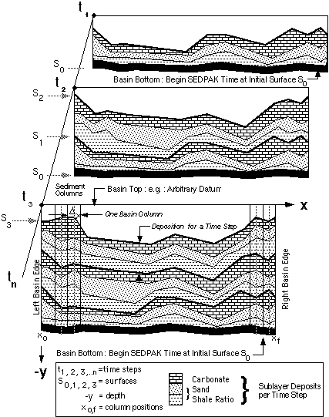
Steps Simulation - Sedimentary Fill

Slide 27
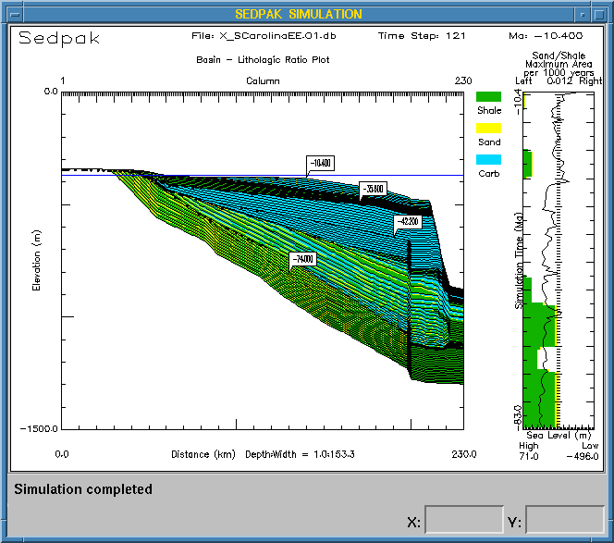
Sedpak Output

Slide 28
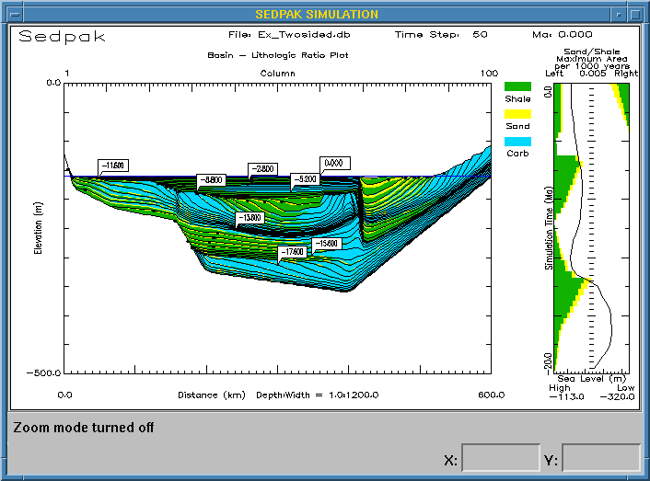
Sedpak Output

Slide 29
Sedpak Launch Menu
Type command “Sedpak”
Click box!

Slide 30
Sedpak Edit Menu

Slide 31
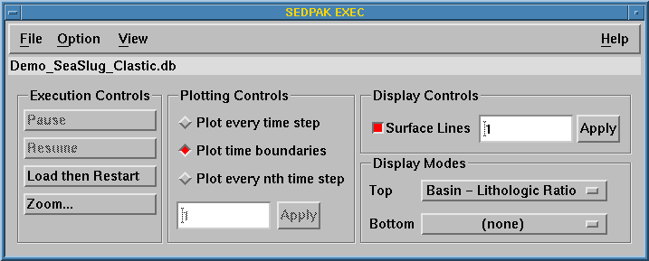
Sedpak Execution Menu

Slide 32
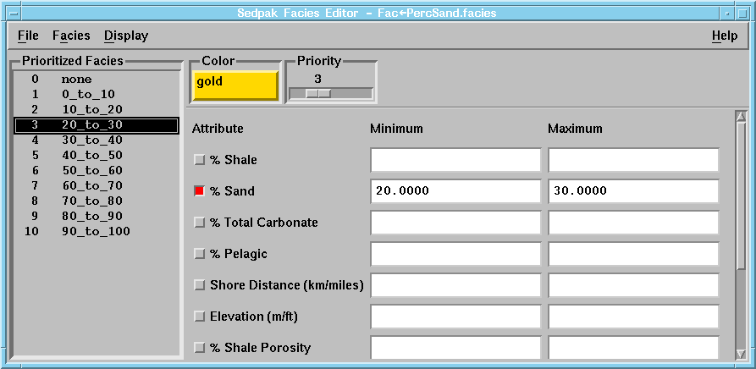
Sedpak Facies Menu

Slide 33
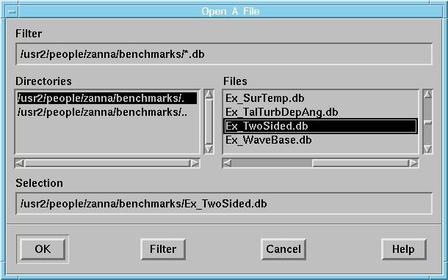
Sedpak Open File For Execution or Edit

Slide 34
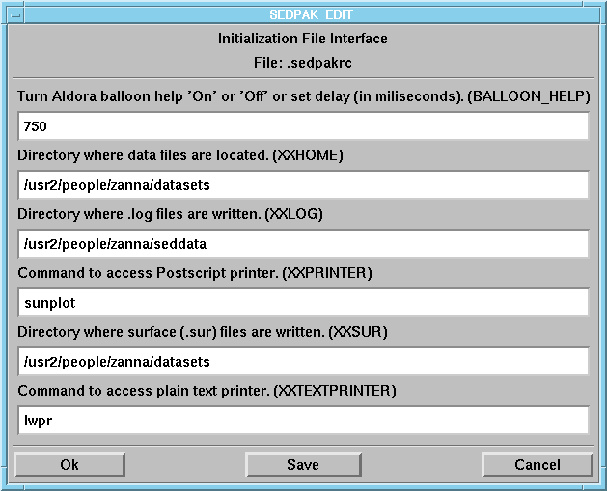
Sedpak Initialization Menu

Slide 35
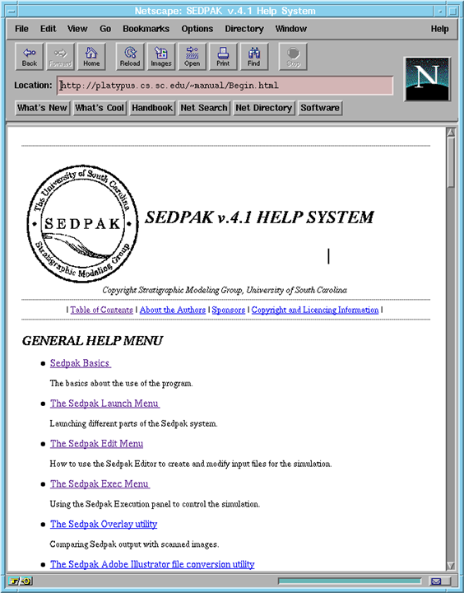
Sedpak Launch Help Files

Slide 36
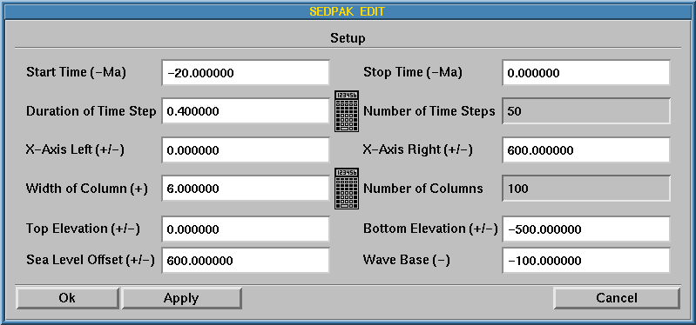
Sedpak Setup Menu

Slide 37
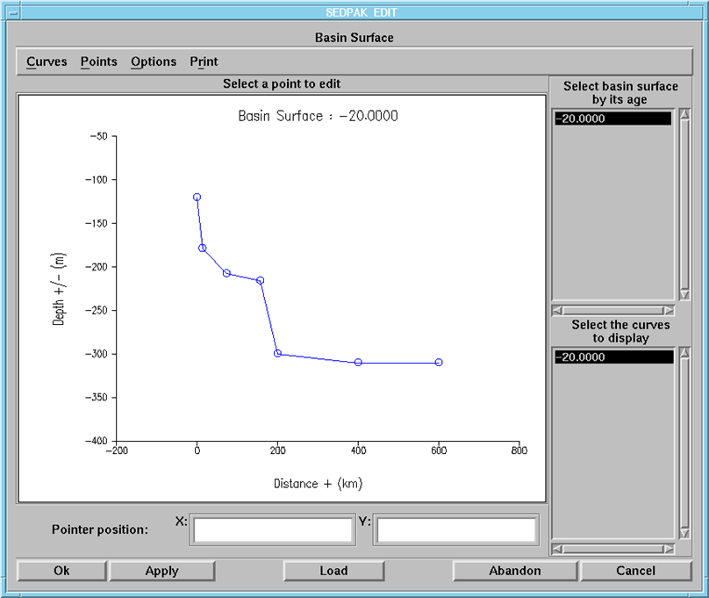
Sedpak Basin Surface Menu

Slide 38
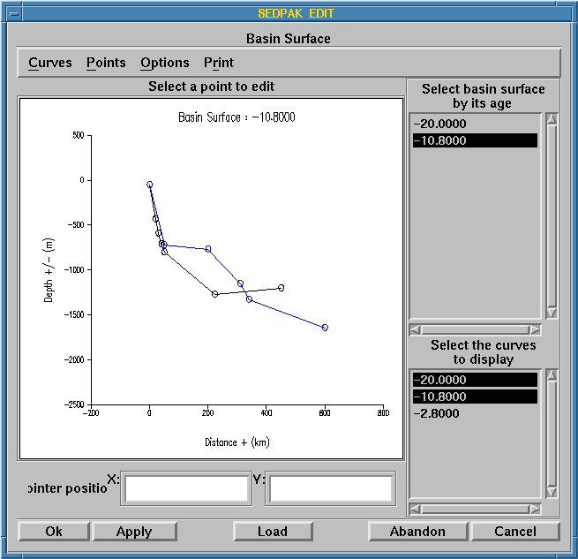
Sedpak Basin Surface Menu

Slide 39
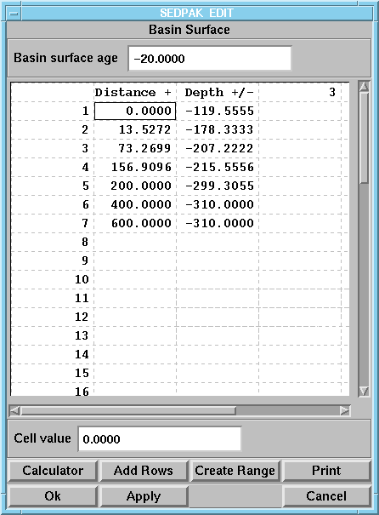
Sedpak Basin Surface Menu

Slide 40
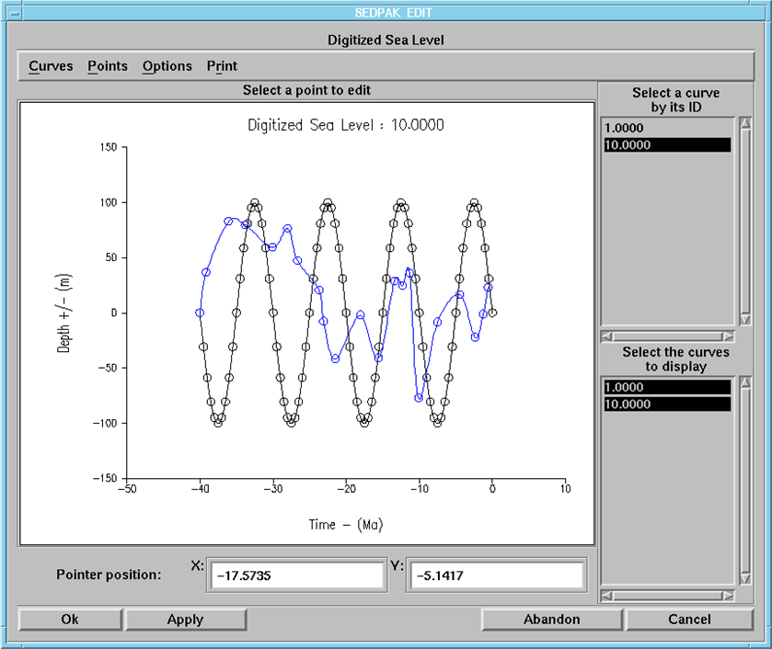
Sedpak Sea Level Menu

Slide 41
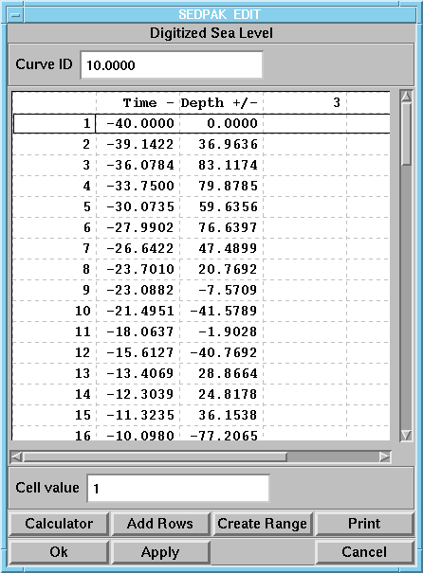
Sedpak Basin Surface Menu

Slide 42
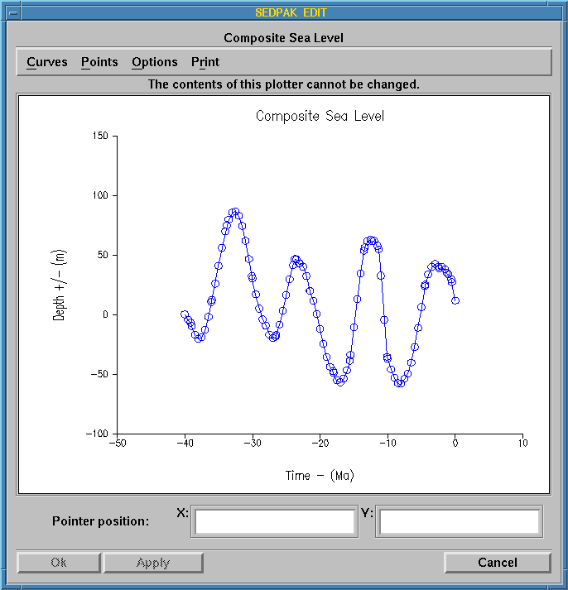
Sedpak Composite Sea Level Menu

Slide 43
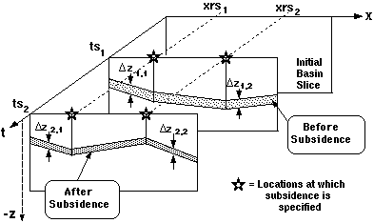
Sedpak Basin Surface & Subsidence

Slide 44
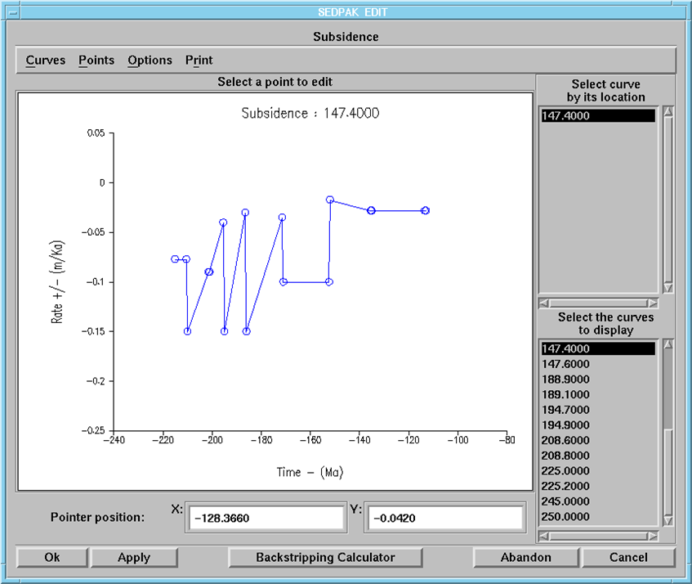
Sedpak Subsidence Menu

Slide 45
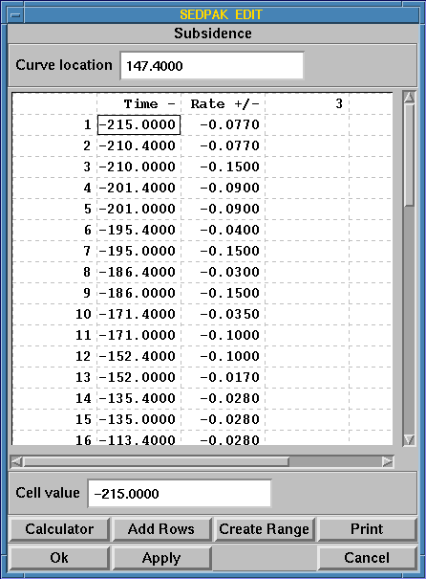
Sedpak Subsidence Menu

Slide 46
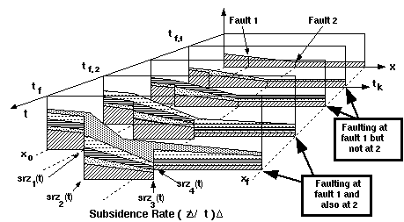
Sedpak Subsidence and Faulting

Slide 47
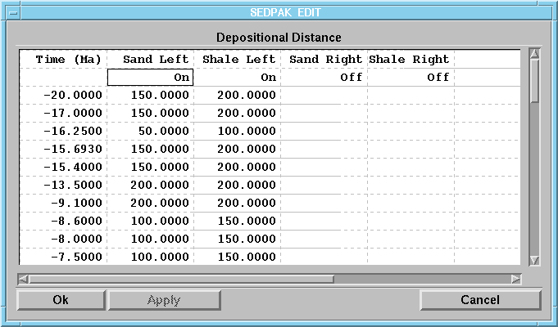
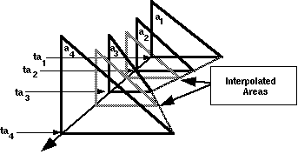
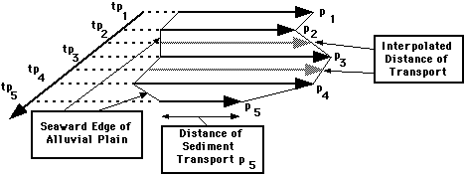
Sedpak Depositional Distance Menu

Slide 48
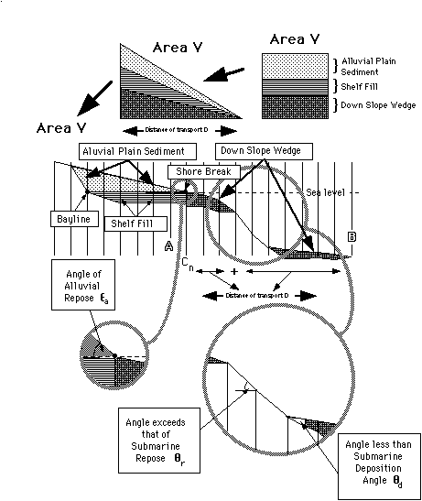
Sedpak - Areas of Sediment Deposited

Slide 49
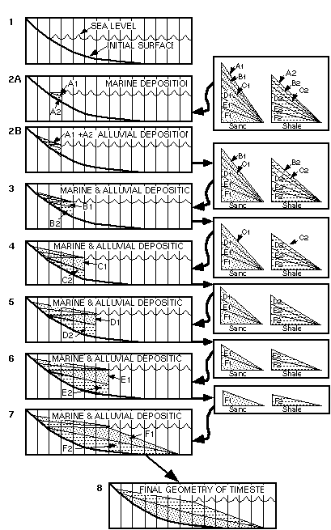
Sedpak - Areas of Sediment Deposited

Slide 50
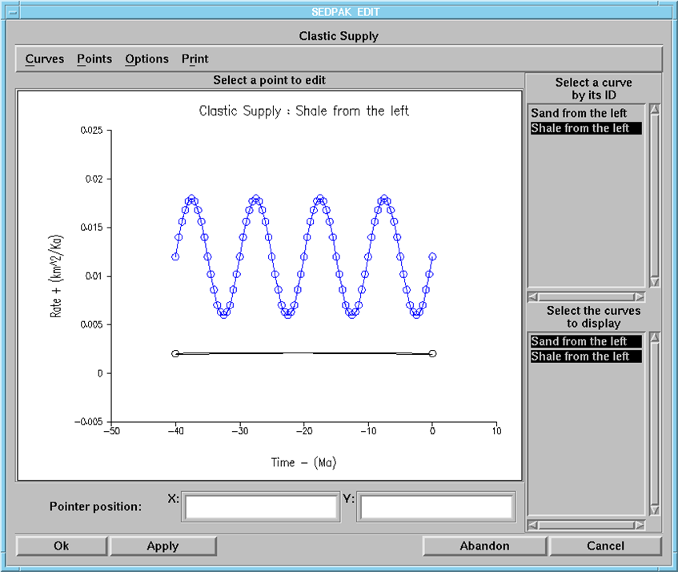
Sedpak Clastic Supply Menu

Slide 51
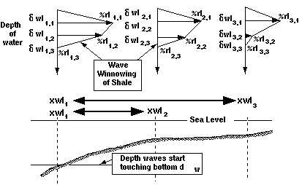
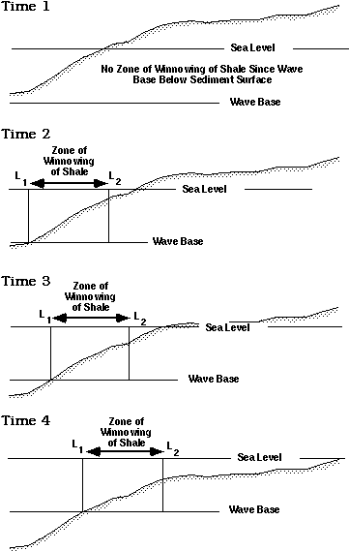
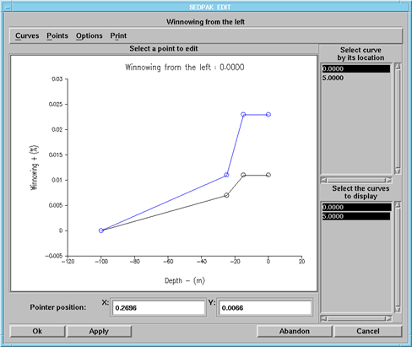
Sedpak Winnowing of Fines - Menu

Slide 52
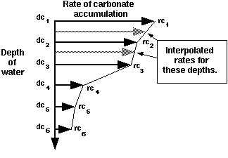
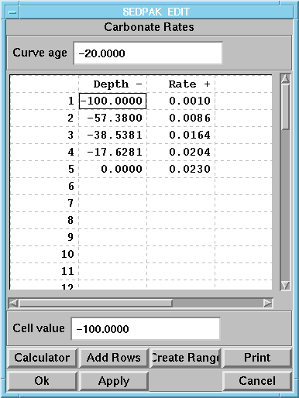
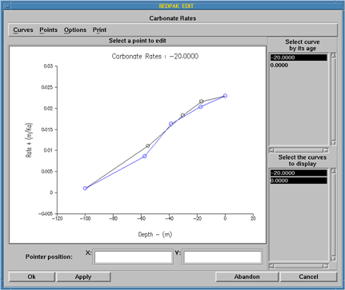
Sedpak Carbonate Accumulation Rates Menu

Slide 53
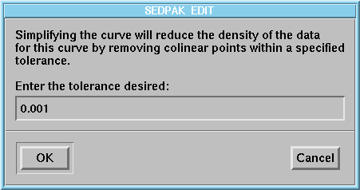
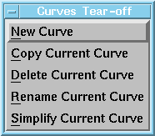
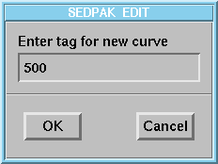
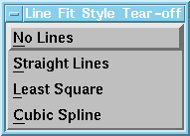
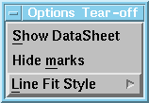
Sedpak Assorted Menus

Slide 54
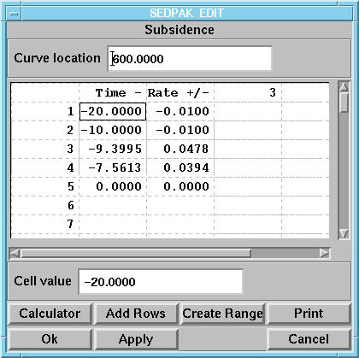
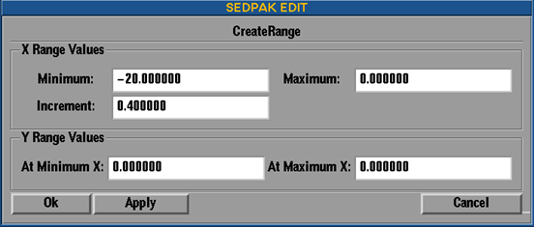
Sedpak Subsidence Location Menu

Slide 55
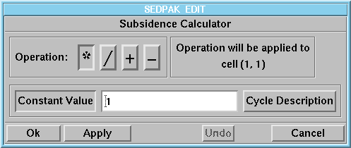
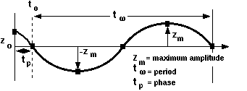
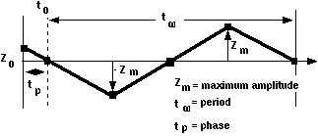
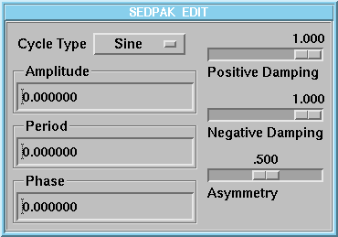
Sedpak Calculators Menu

Slide 56
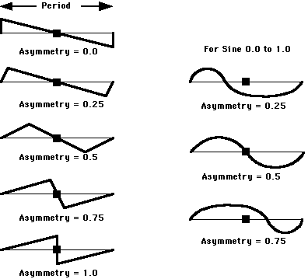
Sedpak – Cycle Types

Slide 57
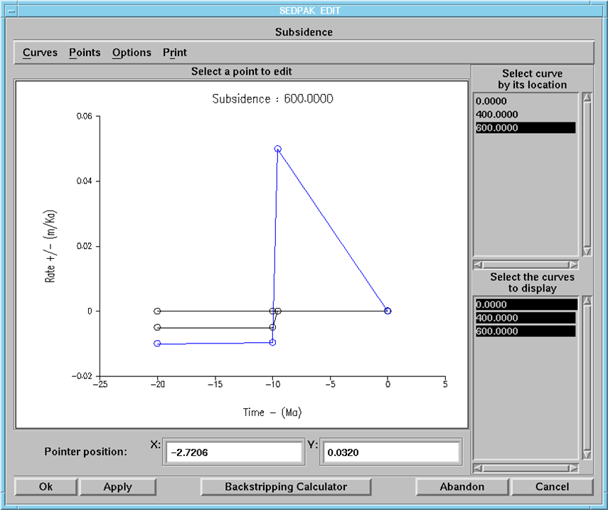
Sedpak – Subsidence Menu

Slide 58
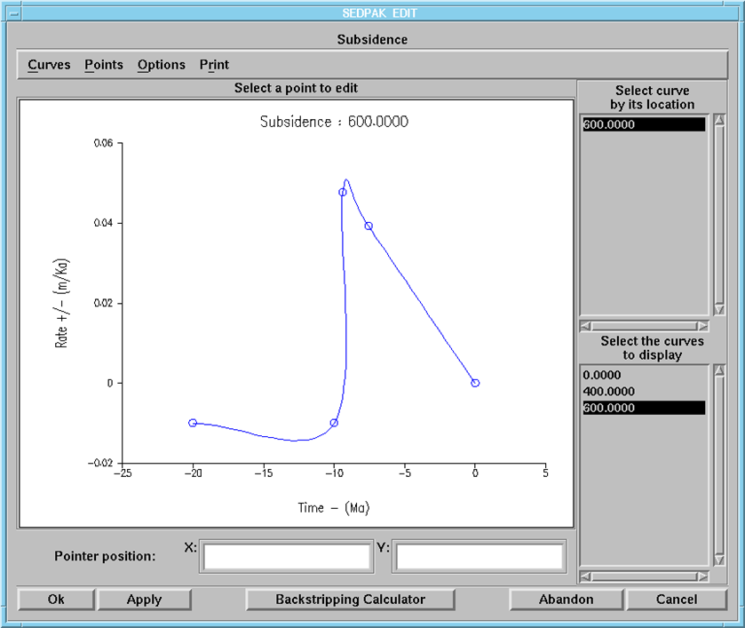
Sedpak Basin Surface Menu

Slide 59
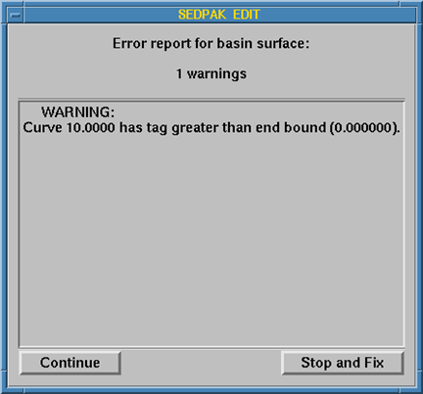
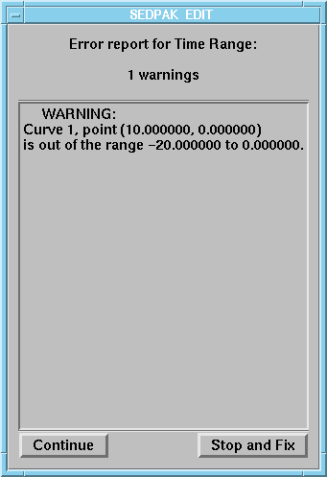
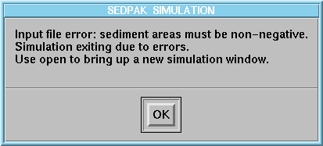
Sedpak Warning Notices

Slide 60
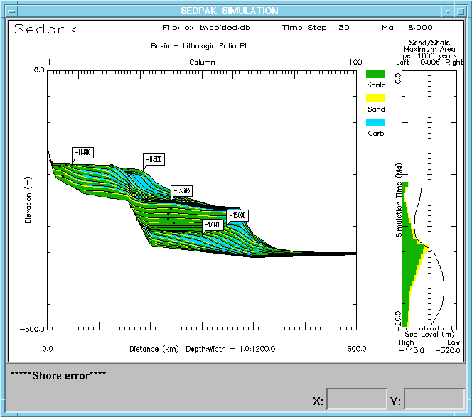
Sedpak Shore Failure Warning

Slide 61
Sedpak Warnings

Slide 62
Sedpak Execution Menu

Slide 63
Sedpak Zoom Menus

Slide 64
Sedpak Output of Dual Screens

Slide 65
Sedpak Execution Menu

Slide 66
Sedpak Execution Menu

Slide 67
Sedpak Execution Menu

Slide 68
Sedpak Execution Menu

Slide 69
Sedpak Execution Menu

Slide 70
Sedpak Execution Menu

Slide 71
Sedpak Execution Menu

Slide 72
Sedpak Execution Menu

Slide 73
Sedpak Execution Menu

Slide 74
Sedpak Execution Menu

Slide 75
Sedpak Execution Menu

Slide 76
Sedpak Execution Menu

Slide 77
Simulation Limitations
Simulation model quality
Models represent an average or approximation of reality & involve identification & simplification of essential parameters
A simulation model is only as good as assumptions that go into it & encompass preconceived concepts & biases of designer & builder
Models often do not honor data
Most process driven simulations are capable of modeling from reservoir scale to sub-reservoir scale to grain movement; not capable of large scale models
Most empirical simulations are capable of modeling from regional scale to field scale to reservoir scale; not capable of small scale models

Slide 78
Simulation Limitations
Boundary conditions/edge effects: Common to all simulations & occur with respect to time &/or space
A shoreline for siliciclastic sedimentation result in defining nearly vertical margin at simulation edge & results in unrealistic geometries close to margin
Abrupt changes in lithology or facies can occur at column or grid boundaries
Physical laws or empirical relationships used successfully within center portion of simulation do not produce realistic results at edges
Geometries of bypassing sediments close to simulation edge become an unrealistic series of "en echelon" parallel beds
Solution makes basin slightly larger than actual area of interest (on the order of 50%, 25% on each side)

Slide 79
Carbonate Example - Simulation
Show how carbonate sequence geometries at continental margins have distinct architectures that can be tied to specific eustatic events and gain experience with simulating carbonate sedimentation using a Bahamas dataset
Start with execution of a simulation of Bahamas platform
Work examples of how rates of benthic carbonate accumulation, pelagic deposition, & carbonate parameters effect carbonate geometries
End with how to build carbonate geometries

Slide 80
Carbonate Example - Simulation
Seismic profiles of northwestern Great Bahamas Bank document lateral growth of isolated platforms joined together by margin progradation to form larger banks
Mechanism responsible for evolution from aggradation to progradation was sediment overproduction on platform
Excess sediment transported offbank & caused a decrease in accommodation space on marginal slope
Progradation occurred in pulses that are interpreted to result from third-order sea level fluctuations (Eberli and Ginsburg, 1987, 1989)
Limited well control has prevented confirmation of these hypotheses, but a simulation can constrain & test proposed theory for platform evolution

Slide 81
Carbonate Example – Simulation of Bahamas

Slide 82
Carbonate Example – Simulation West Andros

Slide 83
Carbonate Example – Simulation West Andros

Slide 84
Carbonate Example – Simulation West Andros

Slide 85
Carbonate Example – Simulation West Andros

Slide 86
Carbonate Example – Simulation West Andros

Slide 87
Carbonate Example – Simulation West Andros
Initiate simulation of Bahamas:
Derive initial basin surface by modifying existing files using paleobathymetry at start of simulation
Use original shape of basin & geometry of sedimentary fill seen on seismic cross-section
Next define tectonic history & run simulation with no sediment to match evolved shape of initial basin surface with seismic cross-section
From subsidence history of cross-section note how tectonic behavior controls accommodation of basin
Vary rates of benthic and pelagic accumulation & set parameters to match carbonate geometries as function of Neogene of Haq et al 1987 eustatic chart to best match of gross simulation geometries with seismic section

Slide 88
Carbonate Example – Simulation West Andros

Slide 89
Carbonate Example – Simulation West Andros

Slide 90
Carbonate Example – Simulation West Andros
Each prograding sigmoidal sequence of succession on seismic formed by a single cycle of sea level fall & rise (Eberli & Ginsburg, 1989)
Carbonate production is highest in photic zone (Schlager, 1981) & unchanged in last 30 million years
Pulses of progradation coincide with third-order sea level fluctuations
Offbank transport is mechanism that supplies sediment to slopes (Hine et al., 1981)
Offbank transport is from east to west on leeside of platform (Hine et al., 1981)
Space reduced on slope prerequisite for progradation
Different basin widths & depths result in different timings for progradation

Slide 91
Carbonate/Clastic Example - Simulation
Gain experience with simulating carbonate & clastic sedimentation, & see how distinct architectures, clastic & carbonate sequences, are tied to eustatic events in Neuquen Basin. See how:
Eustastic events produce distinct responses in a mixed clastic/ carbonate margin
Tectonic movement & rates of mixed clastic/carbonate accumulation effect sediment geometries of simulation
Initial basin surface changes elevation in response to tectonic movement
Changes in eustatic position & rates sedimentation effect platform architecture
Examine Upper Jurassic & Lower Cretaceous of Haq et al 1987 eustatic chart and compare to each Neuquen Basin sequence

Slide 92
Carbonate/Clastic Example - Simulation
Initiate simulation of Neuquen Basin:
Derive initial basin surface by modifying existing files using paleobathymetry at start of simulation
Use original shape of basin & geometry of sedimentary fill seen on the well cross-section
Next define tectonic history & run simulation with no sediment to match evolved shape of initial basin surface with well cross-section
From subsidence history of cross-section note how tectonic behavior controls accommodation of basin
Vary rates of deposition, distances of transport, & angles of repose & deposition as function of Upper Jurassic & Lower Cretaceous of Haq et al 1987 eustatic chart to best match of gross simulation geometries with well cross-section
Vary rates of benthic and pelagic accumulation & set parameters to match carbonate geometries

Slide 93
Carbonate/Clastic Example - Simulation
Neuquen Basin second most prolific hydrocarbon producer in Argentina located in west-central Argentina in a Jurassic-Cretaceous rifted depositional basin
Sediments thicken to west & northwest with a clinoform depositonal pattern, western boundary terminated against the north-south Tertiary structures of Andes Mtns
Thick portions of successive sequences are displaced laterally by strongly prograding pattern of basin fill & clear clinoform tops that define sequence boundaries
Mitchum and Uliana (1985) established sequence stratigraphy of Tithonian, Berriasian, & Valanginian mixed clastic/carbonate, subdivided into series of nine depositional sequences (units A-J) of the Loma Montosa, Quintuco, & Vaca Muerta Formations (-138 Ma to -120 Ma)
Subsidence histories for Neuquen wells suggest a slow & constant rate of thermal subsidence
Siliciclastic sediment influx was fairly constant & moderately low, with abundant autochthonous shallow water carbonate deposits that included oolites
In the late Cretaceous a thick unit of red beds was deposited in a broad poorly defined basin

Slide 94
Carbonate/Clastic Example - Simulation

Slide 95
Carbonate/Clastic Example - Simulation

Slide 96
Carbonate/Clastic Example - Simulation

Slide 97
Carbonate/Clastic Example - Simulation

Slide 98
Carbonate/Clastic Example - Simulation
Experienced simulating carbonate & clastic sedimentation & seen how distinct architectures, clastic & carbonate sequences are tied to eustatic events in Neuquen Basin. Seen how:
Eustastic events produce distinct responses in a mixed clastic/ carbonate margin
Tectonic movement & rates of mixed clastic/carbonate accumulation effect sediment geometries of simulation
Initial basin surface changes elevation in response to tectonic movement
Changes in eustatic position & rates sedimentation effect platform architecture
Seen how Upper Jurassic & Lower Cretaceous of Haq et al 1987 eustatic chart may control character of Neuquen Basin sedimentary sequence

Slide 99
Conclusions and Future
Carbonate models are a mix of process driven empirical, and deterministic
Input variables are know but their value has to inferred from the geologic record
Carbonate models are going 3D
Subsurface models commonly oil field based
Backstripped interpreted sections replacing models
Surrealistic movies worth a thousand words
Need work with example like Arabian Gulf

Slide 100
Sequence Stratigraphic Principles
The distribution of stratigraphic signatures in time and space in the rock record (from Vail et al., 1991).
 | Tectonics |  |  | Eustasy |  |  | Sedimentation
Signatures | Sedimentary basin | Major Trangressive/Regressive facies cycle | Folding Faulting Magmatism and Diapirism | Major continental flooding cycle | Major Trangressive/Regressive facies cycle | Sequence cycle Systems tracts Periodic parasequence | Depostional system Lithofacies tracts Episodic parasequence Marker beds Beds Laminae
Distribution in space | Regional | Regional | Local | Global | Global | Global | Local
Distribution in time | 1st Order Episodic Event | 2nd Order Non-periodic | 3rd Order Episodic Event | 1st Order Cycle | 2nd Order Cycle | 3rd-6th Order Cycles | Episodic Event
Causes | Crustal extension Thermal cooling Flexure loading | Changes in rate of 1) Tectonic subsidence 2) Sediment supply | Local and regional stress release | Changes in ocean basin volume | Changes in ocean basin volume | Changes in climate, water volume | Local sedimentary processes

Slide 101
Sequence Stratigraphic Principles
Stratigraphic cycles and their causes (from Miall, 1990).
Type | Other terms | Duration, m.y. | Probable cause
First Order | - | 200-400 | Major eustatic cycles caused by formation and breakup of super-continents
Second Order | Supercycle (Vail et al., 1977b); sequence (Sloss, 1963) | 10-100 | Eustatic cycles induced by volume changes in global midoceanic spreading ridge system
Third Order | Mesothem (Ramsbottom, 1979); megacyclothem (Heckel, 1986) | 1-10 | Possibly produced by ridge changes and continental ice growth and decay
Fourth Order | Cyclothem (Wanless and Weller, 1932); major cycle (Heckel, 1986) | 0.2-0.5 | Milankovitch glacioeustatic cycles, astronomical forcing
Fifth Order | Minor cycle (Heckel, 1986) | 0.01-0.2 | Milankovitch glacioeustatic cycles, astronomical forcing

Slide 102
Sequence Stratigraphic Principles

Slide 103
Sequence Stratigraphic Principles

Slide 104
Sequence Stratigraphic Principles

Slide 105
Sequence Stratigraphic Principles

Slide 106
Sequence Stratigraphic Principles

Slide 107
Sequence Stratigraphic Principles

Slide 108
Sequence Stratigraphic Principles

Slide 109
Sequence Stratigraphic Principles

Slide 110
Sequence Stratigraphic Principles

Slide 111
Sequence Stratigraphic Principles

Slide 112
Sequence Stratigraphic Principles

Slide 113
Sequence Stratigraphic Principles

Slide 114
Sequence Stratigraphic Principles

Slide 115
Sequence Stratigraphic Principles

Slide 116
Sequence Stratigraphic Principles

Slide 117
Sequence Stratigraphic Principles

Slide 118
Sequence Stratigraphic Principles

Slide 119
Sequence Stratigraphic Principles

Slide 120
Sequence Stratigraphic Principles

Slide 121
Sequence Stratigraphic Principles

Slide 122
Clastic Example - Simulation
This exercise shows how:
Original shape of basin affected the geometry of the sedimentary fill
Tectonic history of basin is defined & is major control on overall accommodation of basin
Sea level effects simulation output including unique patterns of toplap, onlap, downlap, 1st & 2nd order unconformities, maximum flooding surfaces, shelf margin wedges & downslope fans

Slide 123
Clastic Example - Simulation
Deposition of Neogene sediments on New Jersey passive continental margin as they responded to eustasy, tectonism, & sediment accumulation:
Sediments are dominated by thick, prograding siliciclastic clinoforms
Ages were constrained by integrated bio- and Sr- isotope stratigraphy of interpreted sequences
Major sequences on shelf and slope identified and correlated by Greenlee et al. (1992) by tying their ages to 2nd & 3rd order events of Haq et al. (1987) sea level chart

Slide 124
Clastic Example - Simulation

Slide 125
Clastic Example - Simulation

Slide 126
Baltimore Canyon Interpreted Seismic
Interpretation after Greenlee et al 1992

Slide 127
Clastic Example - Simulation
Initiate simulation of Baltimore Canyon section:
Derive initial basin surface by modifying existing files using paleobathymetry at start of simulation
Use original shape of basin & geometry of sedimentary fill seen on the seismic cross-section
Next define tectonic history & run simulation with no sediment to match evolved shape of initial basin surface with well section
From subsidence history of cross-section note how tectonic behavior controls accommodation of basin
Vary rates of deposition, distances of transport, & angles of repose & deposition as function of Neogene of Haq et al 1987 eustatic chart to best match of gross simulation geometries with seismic section

Slide 128
Clastic Example - Simulation
Tracks evolution of stratal architecture between sequence boundaries matching ages of sequence boundaries to Haq et al sea level curves:
Assumed how much accommodation space generated by eustatic sea level change & residual accommodation ascribed to tectonic effects
Sedimentation data of simulation changed itteratively until closely approximated interpreted seismic section
Differences between simulated model & interpretation inferred to be the result of either inaccurate sequence interpretations, or inaccurate tectonic data, & while Haq et al ASSUMED correct

Slide 129
Clastic Example - Simulation
Execute simulation file of Baltimore Canyon & see how:
Eustastic events produce distinct responses
Tectonic movement & rates of sedimentation effect sedimentary geometries of output
Watch how changes in eustatic position & rates sedimentation affect the basin architecture & note how initial basin surface changes elevation in response to tectonic movement
Examine Neogene portion of Haq et al 1987 eustatic chart & compare relative position of sea level highs to relative position of each sequence on continental margin

Slide 130
Clastic Example - Simulation
Baltimore Canyon region subsidence rates close to estimate of 0.01 m/ky (Steckler et al., 1988, Cost B-2 well) while towards end of simulation rates exceed this
Eustatic events from Haq et al. (1987) sea level chart
Sediment supply estimated by measuring cross sectional areas of sequences of Greenlee (1989) line & adjusted amount iteratively
Model run from 30.0 Ma to 0 Ma & time steps 0.5 million years
Sequence boundaries set at rapid sea level falls: 30, 25.5, 22.0, 21, 17.5, 16.5, 15.5, 13.8, 12.5, 10.5, 6.5, 5.5 & 3.8 Ma,
Geometries of 13 sequences assumed products of changes in rates of subsidence & sea level while extent of sedimentary fill controlled by rate supply of sediment & distance of transportation
Subsidence across cross section determined by measuring thickness of sediment & dividing by time span of simulation
Subsidence rate then tuned in conjunction with sedimentary fill to ensure the correct thickness for each sequence by varying the rates of subsidence during simulation run
Subsidence values for the salt diapir was added as a final step at 12 M

Slide 131
Clastic Example - Simulation

Slide 132
Clastic Example - Simulation
The general results established by this iterative matching of sequence thicknesses were that:
Rate of subsidence progressively increased from 30 Ma to 0 Ma
Sea level lowstands were associated with greater rate of sediment supply than highstand
Clastic supply for sand was approximately 10% of shale
Distance of transportation was less for sand than shale

Slide 133
Clastic Example - Simulation
Tracks evolution of stratal architecture between sequence boundaries matching ages of sequence boundaries to Haq et al sea level curves:
Assumed how much accommodation space generated by eustatic sea level change, with residual accommodation ascribed to tectonic effects
Sedimentation data of simulation changed iteratively until it closely approximated the interpreted seismic section
Differences between simulated model & interpretation inferred to be result of either inaccurate sequence interpretations, or inaccurate tectonic data, & while Haq et al chart is ASSUMED correct

Slide 134
Lecture Ends!!

